Slide 1
BorrowNet
Smart Campus Resource Sharing Network
Review 2 – Project Review Presentation
DATABASE SYSTEMS ENGINEERING & DISTRIBUTED BACKEND DEVELOPMENT
TEAM
Y. Mohana Priya – 2520090176
V Vaishanavi – 2520090117
Share More. Spend Less. Connect Better.
1

Slide 2
Problem Statement
Why campus resource sharing needs a structured backend
Current Problem
Existing System → Limitations
• Students often need resources only for a short period.
• Buying temporary-use items can be costly and inefficient.
• Sharing is usually handled through friends or messaging groups.
• Availability, reservations and return dates are difficult to track.
• There is no consistent trust, condition or accountability mechanism.
Friends / Groups
Informal communication
Manual Tracking
No central record
No Reservation Control
Overlapping requests
Limited Accountability
Return / condition issues
2

Slide 3
Objectives
What BorrowNet is designed to achieve
Structured Sharing
01
Availability
02
Conflict Prevention
03
Enable students to list, search and borrow campus resources.
Maintain accurate item availability and reservation periods.
Prevent overlapping reservations for the same item.
Accountability
04
Secure Backend
05
Automation
06
Track returns, item condition, ratings and trust.
Use authentication, authorization and transaction handling.
Provide notifications and rule-based penalties.
3

Slide 4
Proposed System
Complete borrowing lifecycle with backend-controlled business rules
01
02
03
04
05
06
07
08
09
Register / Login
List or Search
Check Availability
Borrow Request
Owner Approval
Reservation
Borrow
Return
Condition + Rating
Smart Backend
Student Functions
Admin Functions
Conflict detection
Trust score calculation
Penalty rules
Transaction management
Notifications
Create profile
List / search items
Request & reserve
Track requests
Return & rate
Moderate users/items
Review reports
Handle disputes
Monitor activity
Maintain accountability
4

Slide 5
System Architecture
Client–server flow for BorrowNet
USER
REACT
REST API
SPRING BOOT
BUSINESS LOGIC
MYSQL
RESPONSE
Student
Frontend
Request layer
Backend
Rules + Auth
Persistent data
Notifications
Security Layer
Business Layer
Data Layer
JWT authentication + role-based authorization
Availability, reservation conflicts, trust and penalties
Users, items, requests, reservations and transactions
5

Slide 6
Modules / Functionalities
Core modules planned for the application
Authentication
Item Management
Borrow Requests
Reservation
Register, login, JWT, roles
List, edit, search, categories, images
Create, approve, reject, track
Date validation and conflict prevention
Transaction & Return
Trust & Penalty
Notifications
Admin
Borrow, return, condition, history
Ratings, trust score, late-return rules
Request, approval, reminder, return alerts
Moderation, reports and dispute handling
6

Slide 7
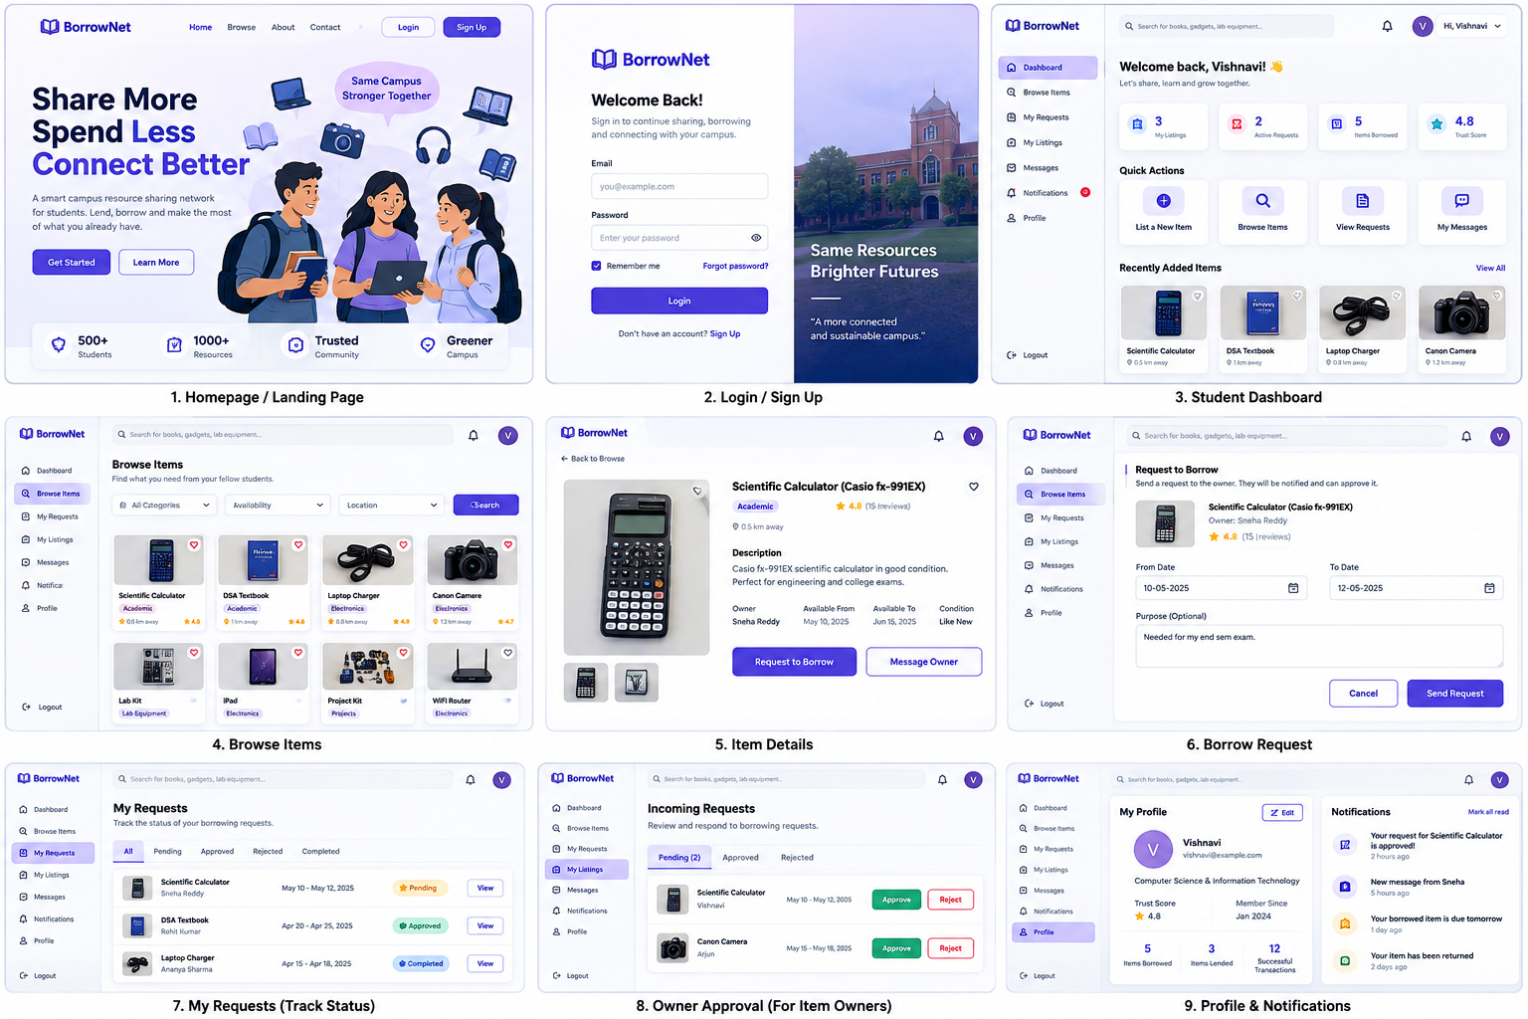
Frontend Design
Planned user experience and navigation
Home Page
Project introduction, search and calls to action.
Login / Registration
Secure entry point for campus users.
Forms
Borrow request and item-listing forms.
Dashboard
Requests, listings, notifications and trust score.
UI prototype screens
7

Slide 8
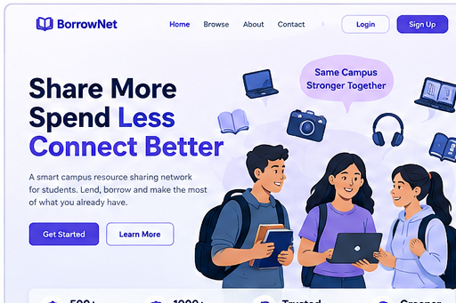
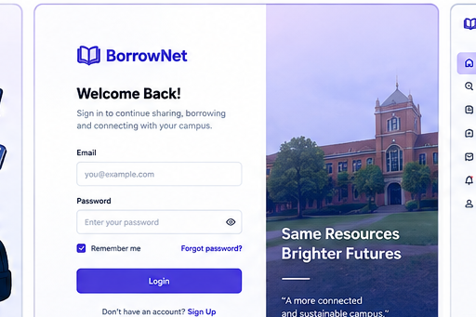
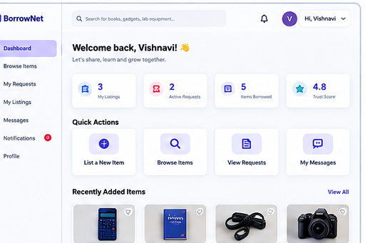
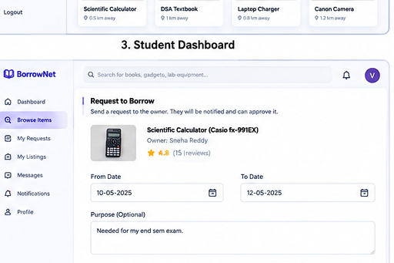
Frontend Implementation – Screenshots
Prototype screens prepared for Review 2; final implementation will be connected to backend APIs
Home Page
Login / Registration
Dashboard
Borrow Request Form
8

Slide 9
Database Design
Relational model supporting the complete borrowing lifecycle
USER
ITEM
CATEGORY
BORROW_REQUEST
user_id PK, name, email, role, trust_score
item_id PK, owner_id FK, category_id FK, condition, availability
category_id PK, category_name
request_id PK, item_id FK, borrower_id FK, owner_id FK, status
RESERVATION
TRANSACTION
RATING
NOTIFICATION
reservation_id PK, request_id FK, item_id FK, dates, status
transaction_id PK, request_id FK, type, status, date
rating_id PK, item_id FK, rater_id FK, rating, review
notification_id PK, user_id FK, type, message, is_read
Additional entities: ITEM_IMAGE and PENALTY support images and accountability records.
9

Slide 10
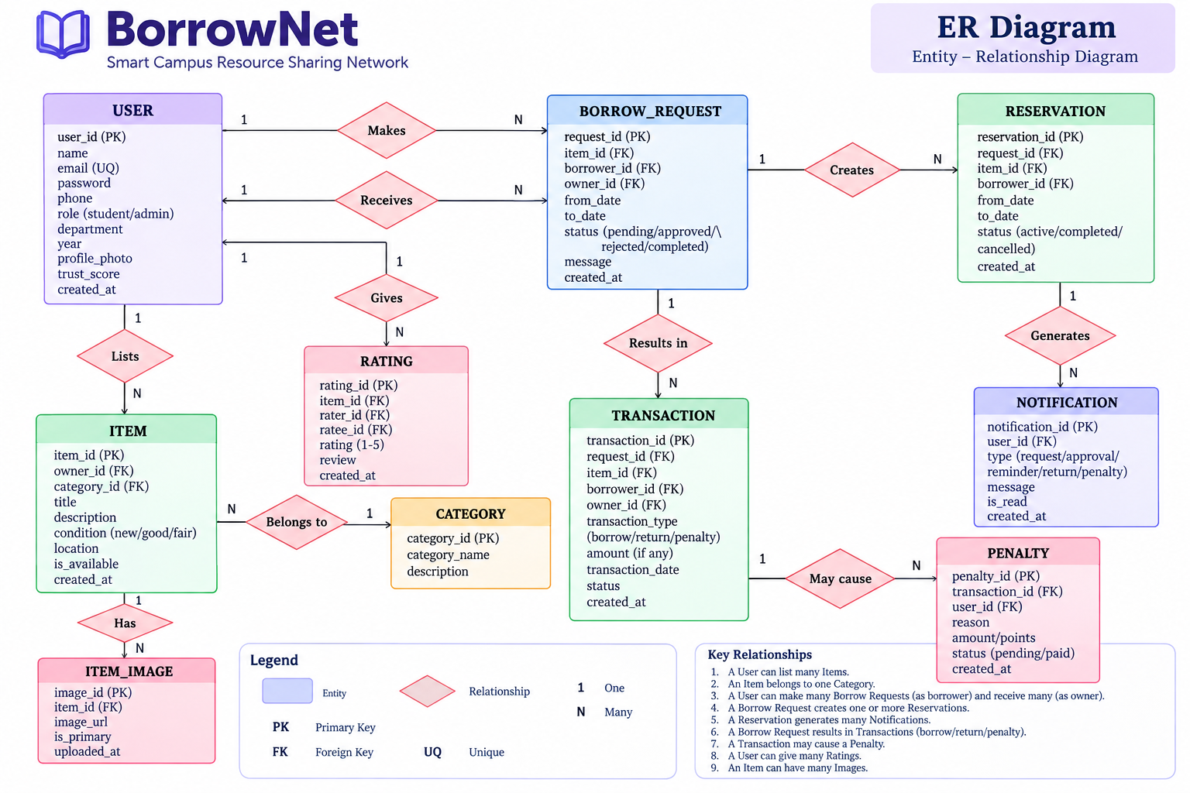
ER Diagram
Entity–Relationship model for BorrowNet
10

Slide 11
Database Tables / Schema & Sample Records
Illustrative records for prototype/testing; final values will come from the implemented database
TABLE | PRIMARY KEY | IMPORTANT FOREIGN KEYS | PURPOSE
USER | user_id | — | User identity, role and trust
ITEM | item_id | owner_id, category_id | Shared resource details
BORROW_REQUEST | request_id | item_id, borrower_id, owner_id | Borrow workflow
RESERVATION | reservation_id | request_id, item_id, borrower_id | Reserved date range
TRANSACTION | transaction_id | request_id, item_id | Borrow / return history
USER – Sample
252001 | Vaishanavi | student | trust 4.8
ITEM – Sample
101 | Scientific Calculator | available | owner 252001
BORROW_REQUEST – Sample
5001 | item 101 | borrower 2520090176 | pending
RESERVATION – Sample
7001 | item 101 | 10–12 May | active
11

Slide 12
Current Progress & Challenges
Review 2 status — show evidence, and clearly separate prototype work from completed implementation
Current Progress
Challenges / Issues
✓ Project abstract and Review 1 documentation prepared.
• Preventing two users from reserving the same item for overlapping dates.
✓ Frontend UI prototype prepared: home, login, dashboard, browse, details and request screens.
• Keeping item availability consistent after approval, borrowing and return.
✓ System architecture and borrowing lifecycle defined.
• Implementing secure role-based access for students and admins.
✓ ER diagram and relational schema designed.
• Handling late returns, penalties and item-condition changes.
✓ Sample records prepared for database testing.
• Testing edge cases and maintaining consistent transaction records.
✓ Backend APIs and database integration are the next implementation stage.
12

Slide 13
Future Work
Planned extensions after the core backend is implemented
Mobile Application
QR Pickup & Return
AI Recommendations
Provide Android/iOS access for faster campus sharing.
Scan an item to confirm handover and return.
Suggest useful resources based on user needs and history.
Demand Prediction
Real-Time Notifications
Analytics
Identify frequently requested resources.
Push reminders for approvals, due dates and returns.
Track sharing activity, popular items and system usage.
13

Slide 14
Conclusion
BorrowNet combines peer-to-peer sharing with practical backend engineering
BorrowNet provides a structured way for students to share resources without unnecessary purchases.
Affordable
Transparent
Accountable
Technical
Use existing campus resources.
Track requests, reservations and returns.
Use ratings, trust and penalties.
Demonstrate APIs, database and backend rules.
Core idea: Share More. Spend Less. Connect Better.
14

Slide 15
THANK YOU
BorrowNet – Smart Campus Resource Sharing Network
Questions?
Share More. Spend Less. Connect Better.
TEAM
Y. Mohana Priya – 2520090176
V Vaishanavi – 2520090117
15

